Slide 1
Input/Output

Slide 2
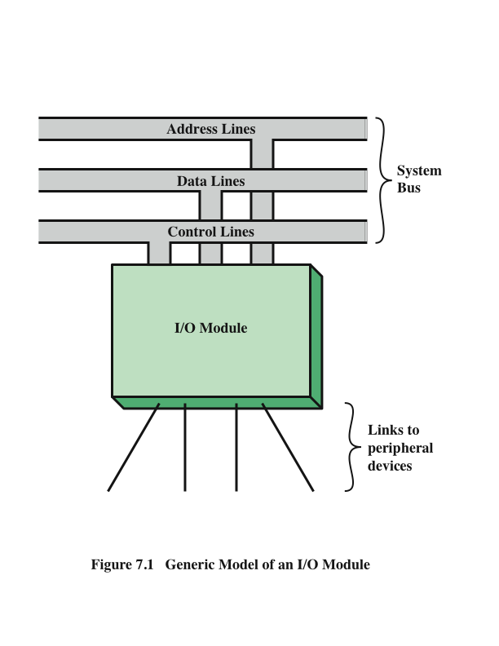
I/O modules are key element of a computer system. Each module interfaces to the system bus and controls one or more peripheral devices. I/O module contains logic for performing a communication function between the peripheral and the bus.

Slide 3
I/O Modules
Why needed?
Computers have a wide variety of peripherals
Delivering different amounts of data, at different speeds, in different formats
Most peripherals are slower than CPU and RAM; a few are faster
Word length for peripherals may vary from the CPU
Data format may vary (e.g., one word might include parity bits)
Two major functions:
Interface to processor or memory via bus or central link
Interface to one or more peripherals via tailored data links

Slide 4
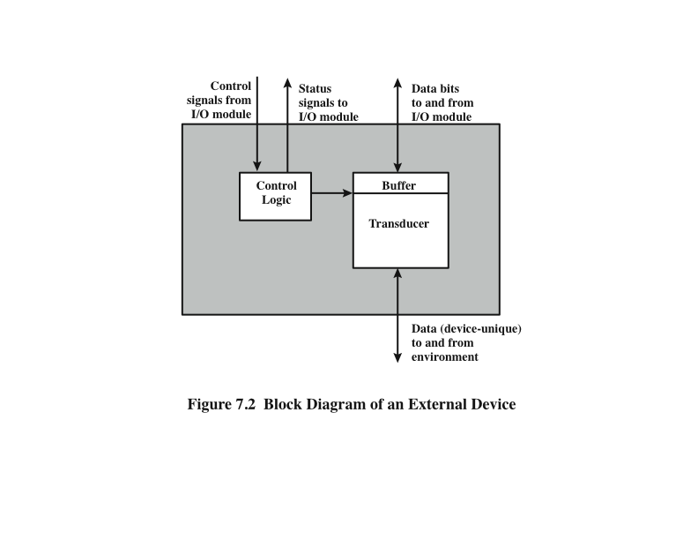
External Device
Provide a means of exchanging data between the external environment and the computer.

Slide 5
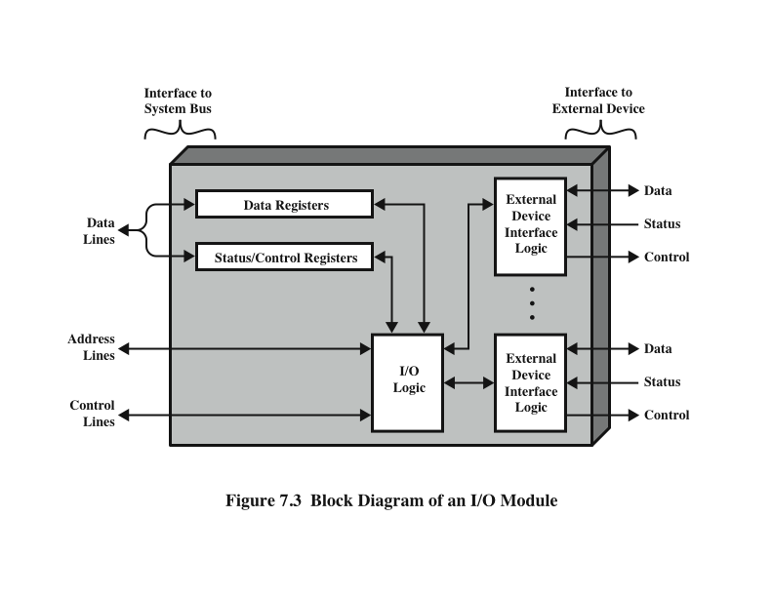
I/O Module

Slide 6
I/O Module Functions
Control and timing
Coordinates the flow of traffic between internal resources and external devices, sharing of resources.
Processor communication
command decoding, data, status reporting, address recognition
Device communication
Data buffering
Error detection

Slide 7
Techniques for I/O Operations
Three techniques are possible for I/O operations:
Programmed I/O
Interrupt-driven I/O
Direct memory access (DMA)

Slide 8
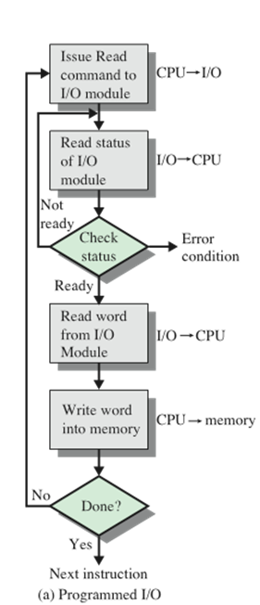
Programmed I/O
When the processor issues a command it must wait until the I/O operation is complete
If the processor is faster than the I/O module this is wasteful of processor time

Slide 9
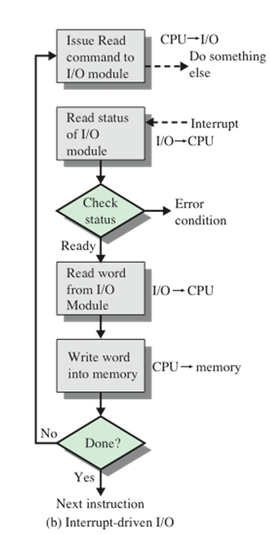
Interrupt-Driven I/O
Processor issues an I/O command, continues to execute other instructions, and is interrupted by the I/O module when the latter has completed its work

Slide 10
Device Identification
Multiple interrupt lines
Software poll
When processor detects an interrupt it branches to an interrupt-service routine whose job is to poll each I/O module to determine which module caused the interrupt.
Daisy chain (hardware poll, vectored)
Interrupt acknowledge line is daisy chained through the modules
Bus arbitration (vectored)
An I/O module must first gain control of the bus before it can raise the interrupt request line

Slide 11
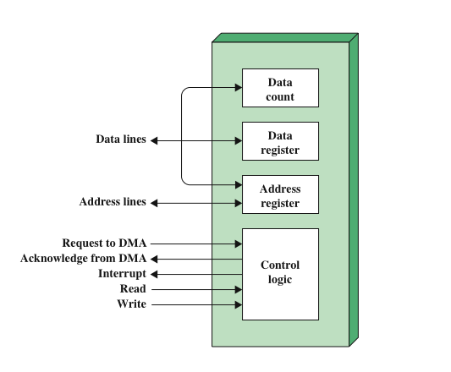
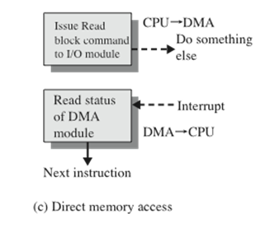
Direct Memory Access (DMA)
I/O module and main memory exchange data directly without processor involvement.

Slide 12
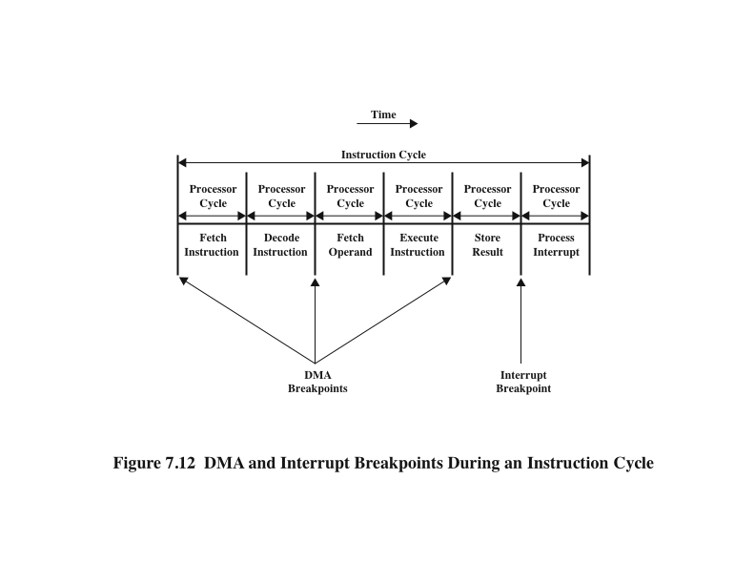
DMA
DMA

Slide 13
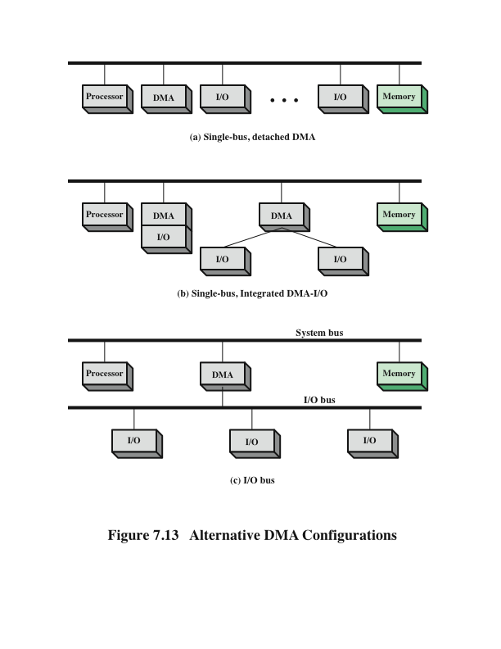
Alternative DMA Configurations
Notes:
The DMA mechanism can be configured in a variety of ways. Some possibilities
are shown in Figure 7.13. In the first example, all modules share the same system
bus. The DMA module, acting as a surrogate processor, uses programmed I/O to
exchange data between memory and an I/O module through the DMA module. This
configuration, while it may be inexpensive, is clearly inefficient. As with processor controlled
programmed I/O, each transfer of a word consumes two bus cycles.
The number of required bus cycles can be cut substantially by integrating the
DMA and I/O functions. As Figure 7.13b indicates, this means that there is a path
between the DMA module and one or more I/O modules that does not include the
system bus. The DMA logic may actually be a part of an I/O module, or it may be a
separate module that controls one or more I/O modules. This concept can be taken
one step further by connecting I/O modules to the DMA module using an I/O bus
(Figure 7.13c). This reduces the number of I/O interfaces in the DMA module to one
and provides for an easily expandable configuration. In both of these cases (Figures
7.13b and c), the system bus that the DMA module shares with the processor and
memory is used by the DMA module only to exchange data with memory. The
exchange of data between the DMA and I/O modules takes place off the system
bus.

Slide 14
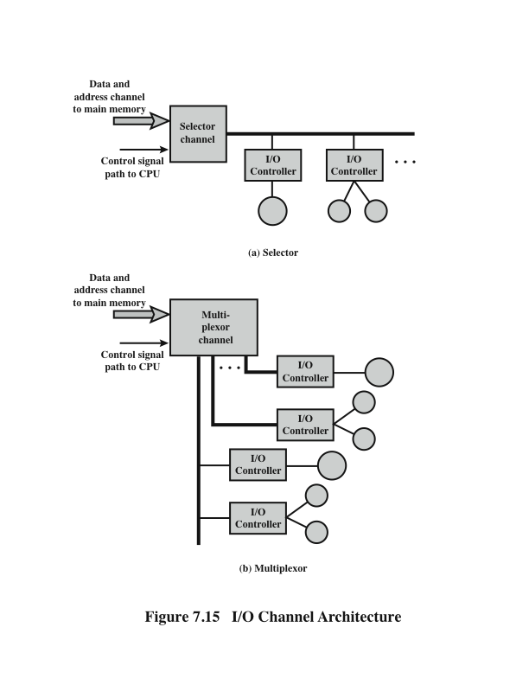
I/O Channel Architecture

Slide 15
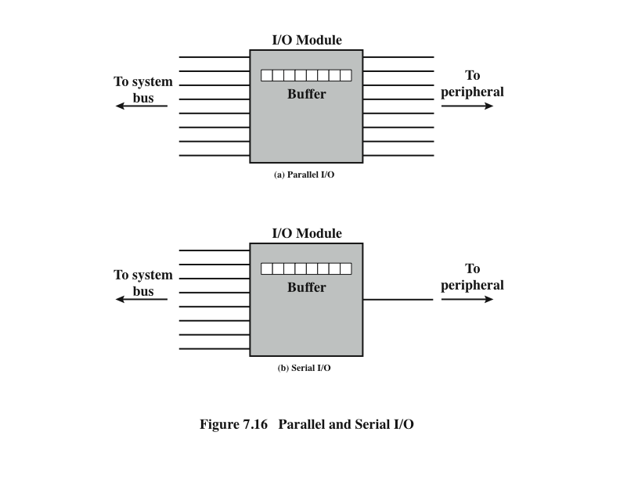
Parallel and Serial I/O

Slide 16
Reference
Computer Organization and Architecture: Designing for Performance, William Stallings, 9th Edition, Pearson India, 2013.

